Slide 1
Chapter 13:
Uncertainity

Slide 2
References:
Stuart Russel, Peter Norvig: Artificial Intelligence - A Modern Approach, 2nd Edition, Pearson Education, 2012.
Elaine Rich, Kevin Knight, Shivashankar B Nair: Artificial Intelligence, 3rd Edition, Tata McGraw Hill, 2011.
Nils J. Nilsson: Principles of Artificial Intelligence, First Edition, Elsevier, 2002.
Luger, G. F., & Stubblefield, W. A., Artificial Intelligence - Structures and Strategies for Complex Problem Solving. New York, NY: Addison Wesley, 5th edition (2005).
Acknowledgement:
All the recourses materials available on the Internet in the area of
Artificial Intelligence

Slide 3
ACTING UNDER UNCERTAINTY
Why do we need to consider uncertainty?
Till now logical agents have stated propositions that are true,false or unknown.
This was possible as the agent knew enough facts about the environment to make the right inferences and even deduce hidden aspects of the environment.
But in reality , agents never have access to the whole truth about the environment. Hence they must act under uncertainty.
Consider the problem as follows ,
Let action A_{t} = leave for airport t minutes before flight .Will A_{t} get me there on time?
Problems to consider :
  partial observability (road state, other drivers' plans, etc.)
  noisy sensors (traffic reports)
  uncertainty in action outcomes (flat tire, etc.)
  immense complexity of modeling and predicting traffic

Slide 4
SOLUTION :
Performance Measures :
  Getting to the airport in time.
  Avoiding long,unproductive wait at the airport.
  Avoid speeding tickets along the way ( Must drive below the speed limit ).
Based on this assume that A₉₀ is expected the maximize the agent’s performance measure.
Hence a purely logical approach either
  risks falsehood: “A₉₀ will get me there on time by driving at a reasonable speed ”, or
  2. leads to conclusions that are too weak for decision making :
“A₉₀ will get me there on time if there's no accident on the bridge and it doesn't rain and my tires remain intact etc etc.”.
You could consider the solution A_{1440 →} Reach the airport on time with a probability of 0.999 .
but I'd have to stay overnight in the airport …

Slide 5
HANDLING UNCERTAIN KNOWLEDGE
ANALYSIS USING FOL
We consider a dental diagnosis using FOL. Let us now consider the rule ,
Vp Symptom(p, Toothache) => Disease(p, Cavity)
This is wrong as there can be infinite other reasons why the patient has toothache such as , an abscess , gum disease , etc.
Now consider every other reason why a person could get a toothache ,
V p Symptom(p, Toothache) =>
Disease(p, Cavity) V Disease(p, GumDisease) V Disease(p,ImpactedWisdom)...
But to make this rule TRUE you’d have to add infinite list of possible clauses which is impossible practically.
Turn the rule into its clausal form ,
Vp Disease(p, Cavity) => Symptom(p, Toothache) //Same problem as before
Hence using FOL fails because :
Laziness : failure to enumerate exceptions, qualifications, etc
Theoritical or →lack of relevant facts, initial conditions, etc.
Practical Ignorance

Slide 6
The agent’s knowledge at the best can provide a degree of belief using probability (0to1).
Probability provides a way of summarizing the uncertainty that comes from our laziness and ignorance.
Eg : P(0.8) = 80% chance that a patient has cavity knowing he/she has toothache.
➔NOTE : Degree of belief != Degree of truth ( fuzzy logic )
80% degree of belief is a fairly strong expectation & 80% truth implies 80 out of 100 are true
For example, suppose that the agent has drawn a card from a shuffled pack.
-Before looking at the card, P(ace of spades) = 1/52. →Prior/Unconditional Probability
-After looking at the card, P(ace of spades) = 0 or 1. →Posterior/Conditional Probability
Thus, Based on evidence (percepts) in the KB an assignment of probability to a proposition is analogous to saying whether or not a given logical sentence (or its negation) is entailed by the KB, rather than whether or not it is true.

Slide 7
MAKING RATIONAL DECITIONS UNDER UNCERTAINTY
Suppose I believe the following:
a)P(A₂₅ gets me there on time | …) = 0.04 c) P(A₁₂₀ gets me there on time | …) = 0.95
b)P(A₉₀ gets me there on time | …)=0.70 d)P(A₁₄₄₀ gets me there on time | …)=0.9999
Which action to choose?
Depends on my preferences for missing flight vs. time spent waiting, etc.
  Utility theory is used to represent and infer preferences
  Decision theory = probability theory + utility theory
  ➔Maximum Expected Utility (MEU)
  This principle states that an agent is rational if and only if it chooses an action that yields highest expected utility averaged over all possible outcomes of the action.

Slide 8
A DECISION-THEORETIC AGENT
(that selects rational actions.)
function DT-AGENT(percept) returns an action
static: belief_state a set probabilistic beliefs about the state of the world
action, the agent’s action
Update belief_state based on action and percept *
calculate outcome probabilities for actions,
given action descriptions and probabilities of current states
select action with highest expected utility
given probabilities of outcomes and utility information
return action
*calculate updated probabilities for current state based on available evidence including current percept and previous action and add it to the belief_state

Slide 9
BASIC PROBABILTY NOTATION
Notations for describing degrees of belief
1. Nature of sentences. 2. Agent experience
Propositions
Degrees of belief are always applied to prepositions.
Probability → More expressive
Random variable
Basic element of language → Refers to part of world whose status is initially unknown.
Ex : Cavity→Left wisdom tooth has a cavity or not ?
Random variable contains domain of values , i.e ,
Cavity has values <true,false>

Slide 10
TYPES OF RANDOM VARIABLES
1.Boolean Random Variables
Eg., Cavity (do I have a cavity?) It can take values : <true,false>
where true → cavity false → ¬ cavity
2.Discrete Random Variables
Eg., Weather is one of <sunny,rainy,cloudy,snow>
Values are mutually exclusive and exhaustive.
3.Continuous Random Variables
a)Entire real line b)Subset of real line (eg, [0,1])
c)Exact values (eg, x=4.2) d) Inequality (eg, x>=4.2 )
Complex Propositions
Simple propositions such as Cavity=true and Toothache=false can be represented as cavity ∧ ¬ toothache.
ATOMIC EVENTS
Defn : An atomic event is a complete specification of the state of the world about which the agent is uncertain.
It assigns a particular value to all variables of which the world is composed of.
Notes:
-\

Slide 11
PROPERTIES OF ATOMIC EVENTS
Mutually exclusive :
At most one event can occur.
Eg : When you toss a coin you can either get a head or a tail , NOT both.
2. Exhaustive :
At least one must be the case ,i.e ,disjunction of all atomic events = true.
Any particular atomic event entails truth or falsehood of every preposition (simple or complex)
Eg : cavity ∧ ¬ toothache entails
a) Truth of - cavity (simple)
b)Falsehood of -toothache (simple)
-cavity ➔ toothache (complex)
4. Any proposition is logically equivalent to the disjunction of all atomic events that entail the truth of the proposition.
cavity ⬄ ( cavity ∧ toothache ) ∨ ( cavity ∧ ¬ toothache )

Slide 12
PRIOR PROBABILITY ( or Unconditional Probability )
It is associated with a preposition ‘a’ is a degree of belief given to it in the absence of any other information.
Eg : P(Cavity=true) =0.1 OR P(cavity)=0.1
This can be done only until no other information is known , if it is known then conditional probability is used .
P(Weather=Sun)=0.7
P(Weather=Rain)=0.2 ➔ P(Weather)=<0.7,0.2,0.08,0.02>
P(Weather=Cloudy)=0.08 This is prior probability distribution
P(Weather=Snow)=0.02 for random variable Weather.
JOINT PROBABILITY
Joint probability distribution for a set of random variables gives the probability of every atomic event on those random variables
  P(Weather,Cavity) = a 4 × 2 matrix of values.
FULL JOINT PROBAILITY of Weather,Cavity,Toothache= 4 × 2 × 2
Weather = | Sunny rain cloudy snow
Cavity = true Cavity = false | 0.144 0.02 0.016 0.02 0.576 0.08 0.064 0.08

Slide 13
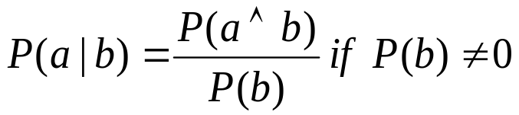
For continuous variables it is not possible to represent as a table because they have infinite values,hence they are represented as parameterized fn of x ,i.e, F(x).
Eg : X → Tomorrow’s maximum temperature in India
P(X=x) = U[18,26] (x) //This is a probability density function,
CONDITIONAL PROBABILITY ( Posterior )
Definition of conditional probability:
Product rule (alternative formulation) :
A general version holds for whole distributions, e.g.,
P(Weather, Cavity) = P(Weather ⏐Cavity) P(Cavity)

Slide 14

PROBLEM (Inference by enumeration)
Start with the joint probability distribution:
Can also compute conditional probabilities:
P(¬cavity | toothache) = P(¬cavity ∧ toothache) / P(toothache)
= (0.016+0.064)/(0.108 + 0.012 + 0.016 + 0.064)
= 0.4

Slide 15
BAYES' theorem
General formula:
p(y/x)=p(x/y)p(y)
p(x)
With normalization:
P(y/x)=aP(X/Y)P(Y)
Use:
effective in medical diagnosis
Usually represented in the form:
P(effect/cause)

Slide 16
Example:
Calculate: P(cavity/toothache^catch)
With normalization:
P(cavity/toothache^catch)=aP(toothache^catch|cavity)P(cavity)
Conditional independence:
P(toothache^catch|cavity) =P(toothache|cavity)P(catch|cavity)
After subsituting:
P(cavity/toothache^catch)=aP(toothache|cavity)P(catch|cavity)P(cavity)
General form of conditional independence:
P(X,Y|Z)=P(X|Z)P(Y|Z)

Slide 17
SUMMARY
• Uncertainty arises because of both laziness and ignorance. It is inescapable in complex, dynamic, or inaccessible worlds.
• Uncertainty means that many of the simplifications that are possible with deductive inference are no longer valid.
• Probabilities express the agent's inability to reach a definite decision regarding the truth of a sentence, and summarize the agent's beliefs.
• Basic probability statements include prior probabilities and conditional probabilities over simple and complex propositions.
• The joint probability distribution specifies the probability of each complete assignment of values to random variables. It is usually far too large to create or use.
• Bayes' rule allows unknown probabilities to be computed from known, stable ones.
• In the general case, combining many pieces of evidence may require assessing a large number of conditional probabilities.
• Conditional independence brought about by direct causal relationships in the domain allows Bayesian updating to work effectively even with multiple pieces of evidence.

Slide 18

Inference Using Full Joint distributions
Probabilistic inference : the computation from observed evidence of posterior Probabilities for query propositions.
For example : a full joint distribution for toothache , cavity , catch world .
NOTE: Elements in table sum to 1 → 3 independent numbers.

Slide 19
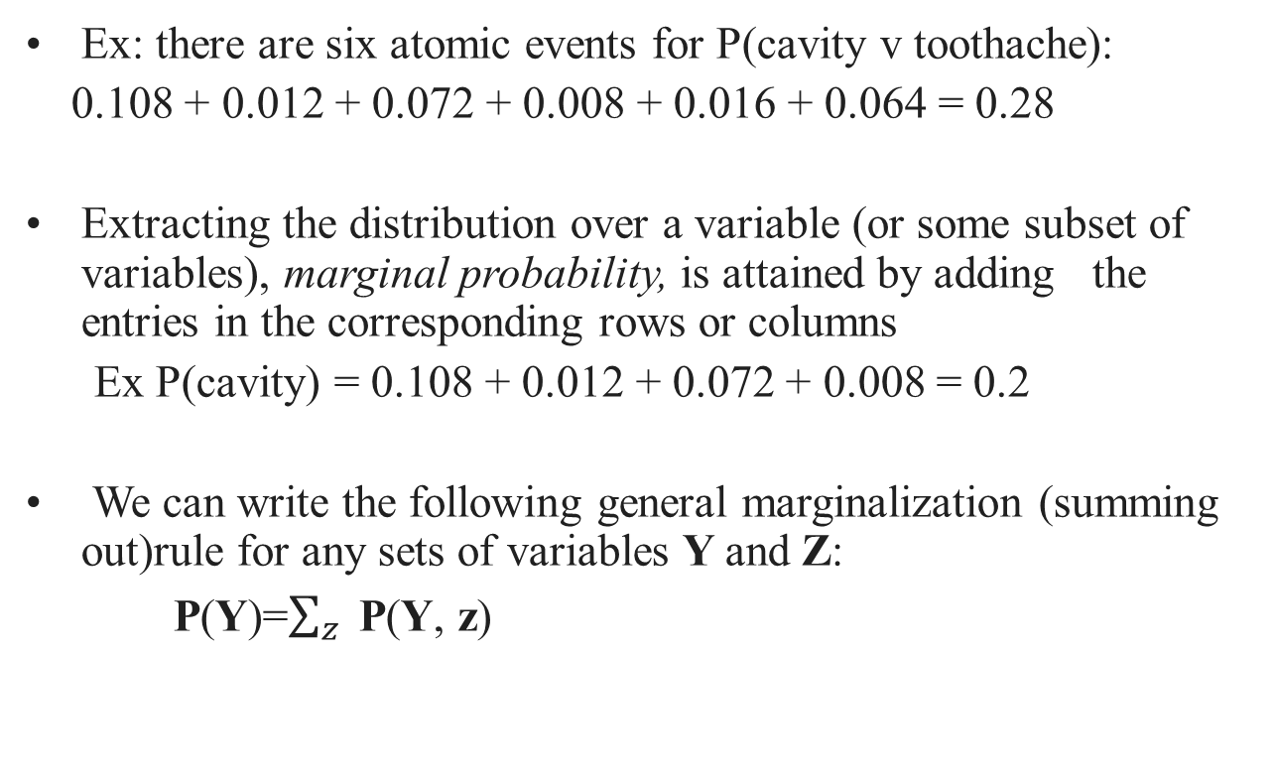
Techniques for manipulating equations involving Probabilities

Slide 20
Techniques for manipulating equations involving Probabilities
Computing a conditional probability of some variables ,
given evidences about others
P(cavity | toothache) = P(cavity ^ štoothache)/P(toothache)
=(0.108 + 0.012)/(0.108 + 0.012 + 0.016 + 0.064)
= 0.12/0.2 = 0.6
P(¬cavity | toothache) = (0.016 + 0.064)/0.2 = 0.4

Slide 21
1/P(toothache) = 1/0.2 = 5 is a normalization constant ensuring that the distribution P(Cavity | toothache) adds up to 1
Let α denote the normalization constant
P(Cavity | toothache) = α P(Cavity, toothache)
= α(P(Cavity, toothache, catch) + P(Cavity , toothache, ¬catch))
=α ([0.108, 0.016] + [0.012, 0.064])
= α[0.12, 0.08]
=[0.6, 0.4]
In other words, we can calculate the conditional probability distribution without knowing P(toothache) using normalization

Slide 22
More generally:
we need to find out the distribution of the query variable X(Cavity),
evidence variables E (Toothache) have observed values e, and
the remaining unobserved variables are Y (Catch)
Evaluation of a query:
P(X | e) =αP(X, e) = αΣy P(X, e, y),
where the summation is over all possible ys; i.e.,
all possible combinations of values of the unobserved variables Y

Slide 23
Given the full joint distribution to work with, the equation in the previous slide can answer probabilistic queries for discrete variables
It does not scale well
For a domain described by n Boolean variables, it requires an input table of size O(2^n) and takes O(2^n) time to process the table
In realistic problems the approach is completely impractical

Slide 24
Independence
If we expand the previous example with a fourth random variable Weather, which has four possible values, we have to copy the table of joint probabilities four times to have 32 entries together
Dental problems have no influence on the weather, hence:
P(Weather = cloudy | toothache, catch, cavity) =
P(Weather = cloudy)
By this observation and product rule
P(toothache, catch, cavity, Weather = cloudy) =
P(Weather = cloudy) P(toothache, catch, cavity)

Slide 25
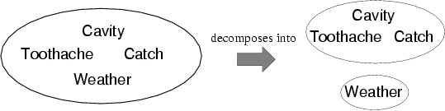
Independence
Propositions a and b are independent if
P(a | b) = P(a) or P(b | a) = P(b) or P(a ^ b) = P(a) P(b)
Respectively variables X and Y are independent of each other if
P(X | Y) = P(X) or P(Y | X) = P(Y) or P(X, Y) = P(X)P(Y)

